Slide 1
AI Final Project
Quick & Draw
TEAM 07

Slide 2
01
classifier

Slide 3
Methodology
RESNET 50 from tensorflow.keras.applications.resnet_v2 import ResNet50V2 model = ResNet50V2(input_shape=(64, 64, 1), weights=None, classes=30) https://keras.io/applications/#available-models
ensemble learning
majority voting
ensemble 4 different models
model1 accuracy: 48.78%
model2 accuracy: 51.22%
model3 accuracy: 41.46%
model4 accuracy: 46.34%

Slide 4
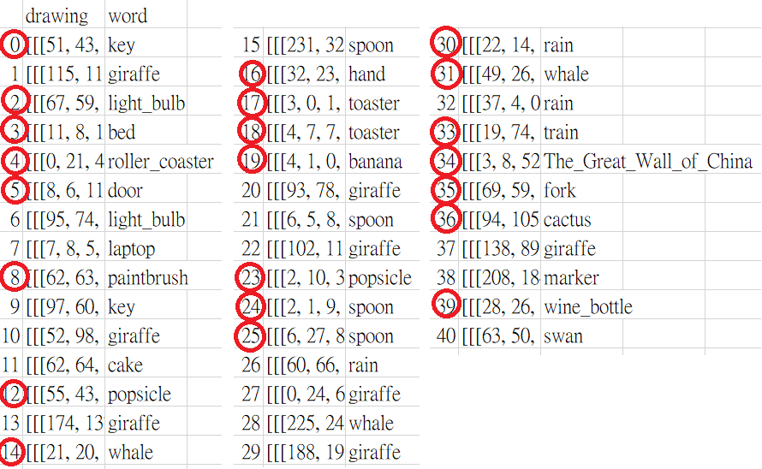
Evaluation & Result
Notes:
圈起來ㄉ是對的

Slide 5
Evaluation & Result
Test Result
# of instances classified correctly: 22 / 41
Accuracy: 53.66%
Demo Result
# of instances classified correctly: 23 / 40
Accuracy: 57.5%

Slide 6
Discussion(1/2)
Google Colab crash
hard drive ability
cloud computing ability should be concerned
We can’t use all datasets
Overfitting
Occurs after 10 epochs
valid accuracy drops and does not come back after 100 epochs
Notes:
0.img_per_class設太高的話google colab會承受不住= =
1.試過從sample classifier自己加layer、改參數，還有keras.applications裡的其他model(https://keras.io/applications/#resnet)
但overfitting還是很嚴重
2.

Slide 7
Discussion(2/2)
Ensemble learning
Composed of 5 model
4 of them trains only 7 epochs with average 43% accuracy
We use majorty vote
Hyperparameter tuning
Learning rate=0.001
Larger learning rate would contributes to early overfitting (model 3)
batch=32, 50, 64, 256
batch number seems to have a much more less effect .
We don’t generate confusion matrix because of the testing set size
Notes:
在Machin Learning學過的ensemble learning沒想到實際用上，對accurarcy有一些幫助

Slide 8
02
generator

Slide 9
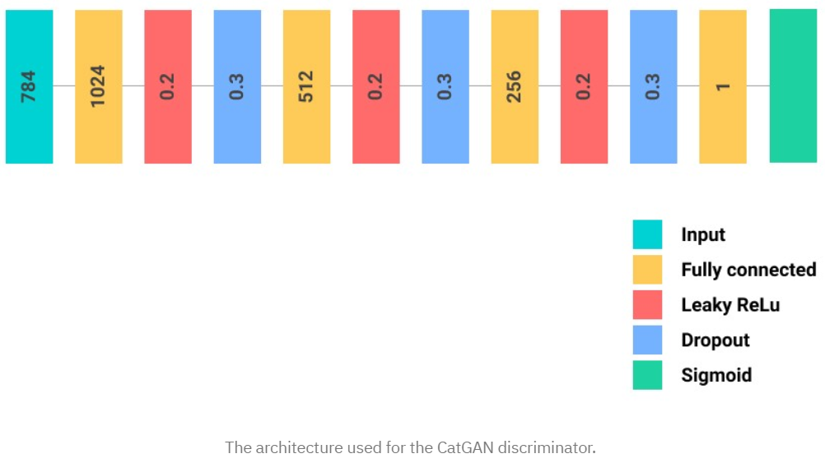
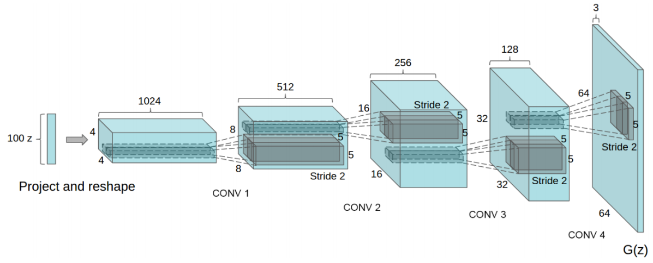
Methodology
catGAN & DCGAN
Notes:
https://github.com/rish-16/CatGAN

Slide 10






Evaluation & Result
Test Result
Demo Result
# of acceptable instances: 92
Subjective：7
Notes:
The silhouette is clear in 20 epochs for simple graphs

Slide 11
Discussion
Discriminator Loss
Too large
Need more training set or epochs
Choosing training epochs
We save a model each 5 epochs
Complex silhouette should have trained about 100 epochs
In the sense of efficiency, 50 epochs are enough for most simple class.
Notes:
2.因為太晚才知道怎麼做，所以每種class的training epoch最多都只到50，如果可以更多的話，說不定圖案效果會看起來更好

Slide 12
Conclusion
Good hardware and enviroment
Build the model "Customizedly”
Require large Training set and epochs
Notes:
in the sense of 100 thousands~A million

